Slide 1
Unit 4: Content
System Development method:
  Information Engineering – Chapter 21 pp 434 – 446
Approach:
  Strategic Information Systems – Chapter 4 pp 53 – 62
Techniques
  Data flow diagrams, Data Structure Diagrams, Decision trees, Decision tables, Structured English, Normalisation – Chapter 11 pp 217 – 242
Dr. D de Villiers : 5th August 2014

Slide 2
Information Engineering (IE)
Information strategy planning. The objective here is to construct an information architecture and a strategy which supports the overall objectives and needs of the organization. This is conducted at the enterprise level. One part of this planning is the identification of relevant business areas.
Business area analysis. The objective here is to understand the individual business areas and determine their system requirements.
System planning and design. The objective here is to establish the behaviour of the systems in a way that the user wants and that is achievable using technology.
Construction and cutover. The objective here is to build and implement the systems as required by the three previous levels.

Slide 3
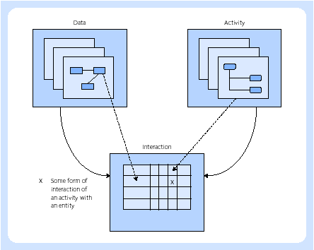
IE – data, activity and interaction

Slide 4
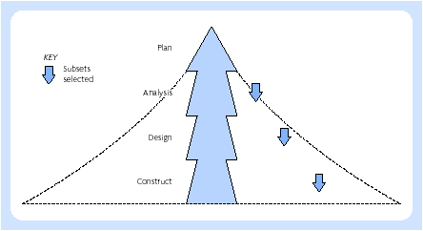
IE – divide and conquer approach

Slide 5
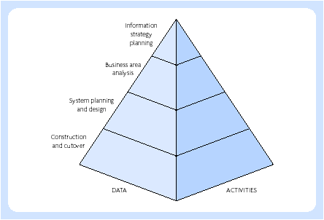
Four levels of IE

Slide 6
Chapter 4
Organisational
Themes

Slide 7
Systems thinking
System
Boundary
Environment
Open systems
Purpose
Soft systems

Slide 8
Information systems strategy
Efficiency
Cost-benefit
Competitive advantage
Effectiveness
  Redefine the boundaries of particular industries
  Develop new products or services
  Change the relationships between suppliers and customers
  Establish barriers to deter new entrants to marketplaces

Slide 9
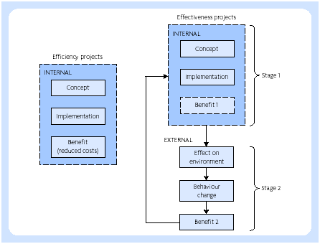
Benefit realisation

Slide 10
Chapter 12
Data Techniques

Slide 11
Normalisation
First normal form – ensure that all the attributes are atomic (i.e. in the smallest possible components). This means that there is only one possible value for each attribute and not a set of values. This is often expressed as the fact that relations must not contain repeating groups.
Second normal form – ensure that all non-key attributes are functionally dependent on (give facts about) all the key. If this is not the case, split off into a separate relation those attributes that are dependent on only part of the key together with the key.
Third normal form – Ensure that all non-key attributes are functionally independent of each other. If this is not the case, create new relations which do not show any non-key dependence.

Slide 12
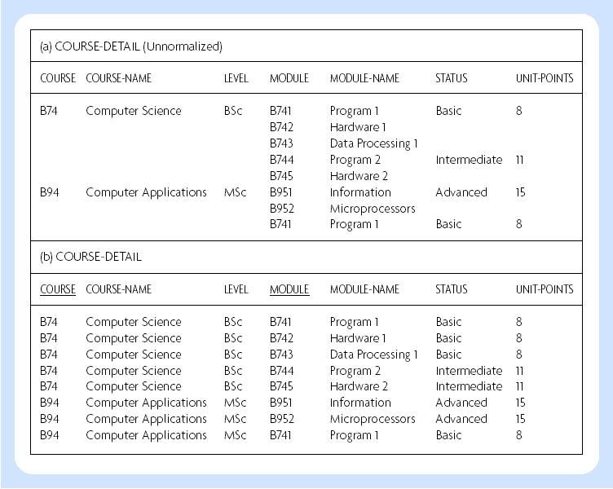
1st normal form

Slide 13
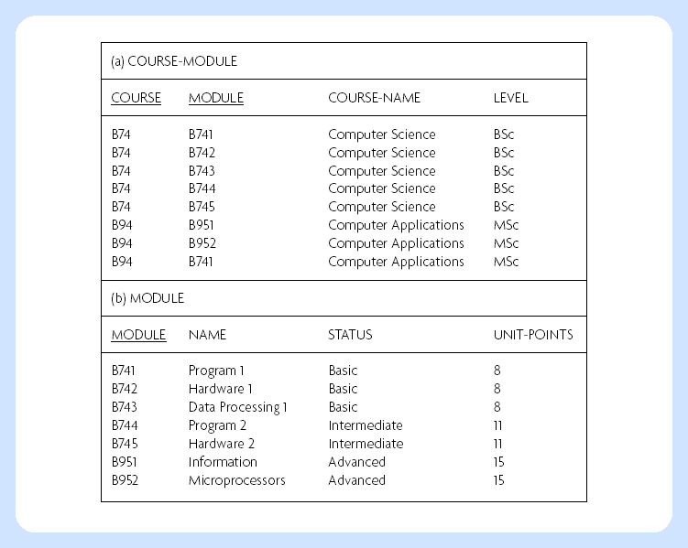
First step toward 2nd normal form

Slide 14
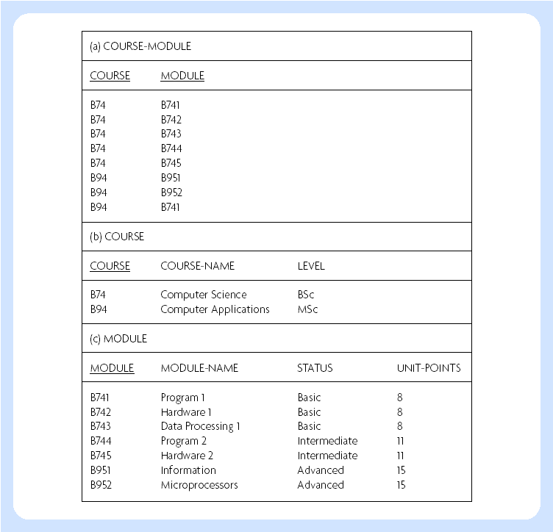
2nd normal form

